Slide 1
Theme 6. Conventional methods of speech processing: beamforming

Slide 2
Beamforming idea
The beamforming technique is one of the most successful sound localization and quantification approaches able to support designers and engineers to rank and quantify individual sound sources.
This technique is very robust allowing to distinguish sources even in challenging situations when the source intensity is many decibels below the background noise level.
This capacity allows designers and engineers to more precisely evaluate noise reduction solutions

Slide 3
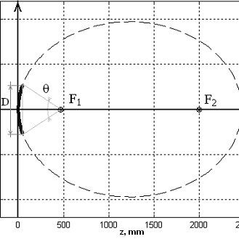
Beamformer’s predecessor - elliptic mirror
From an historical perspective, the beamforming technique is predeceased by elliptic acoustic mirrors.
This approach assumes sound waves propagating as acoustic rays.
Assuming that the sound source is located in the acoustic far-field (in relation to the measurement position), it is possible to focus the acoustic mirror on any point where the sound source is expected to be (acoustic focal point F2). Therefore, the microphone placed in the acoustic focal point F1 will measure the source strictly located in the point F2.
This signal can be Fourier-transformed allowing to quantify the sound source intensity at specific frequency bands.

Slide 4
Beamformer’s predecessor - elliptic mirror
The elliptic mirror performs “spatial filtering” allowing to efficiently distinguish closely located noise sources practically removing the background noise influence.
This technique was largely applied until the early 90’s in the localization of acoustic sources in academic and industrial environments .
However, the elliptic mirror represents to be an expensive technique to be applied.
The large cost is related with the low-productivity of this technique since, for each measurement point, the mirror has to be mechanically moved with help of an accurate traverse system. After that, data should be sampled for some seconds or minutes (depending the required precision), turning the process long and tedious.

Slide 5
After the middle 90’s, advances in digital computers, development of fast data acquisition system, large capacity and fast data storage, turned the microphone array techniques highly attractive to perform acoustic noise source localization and quantification.
Nowadays, the technological development of hardware and software allows experimental researchers to efficiently build (or purchase) very robust microphone arrays equipped with more than a hundred of microphones.
This large technological leap made possible performing very refined noise source localization

Slide 6
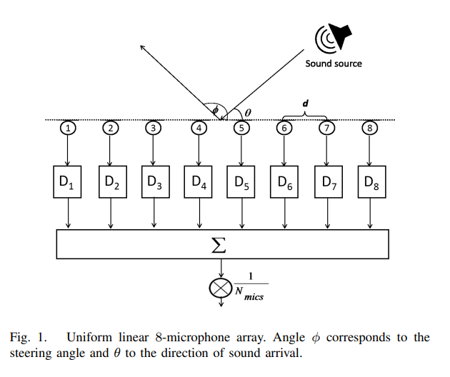
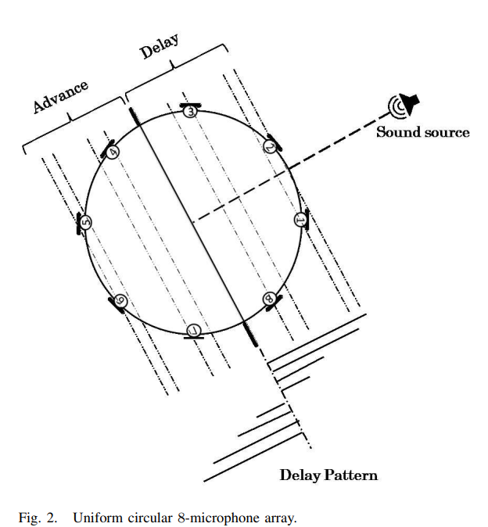
Microphone arrays
The microphone array is the most complex instrumentation required in the application of the beamforming technique.
With the fast development of the smart phones, nowadays we have increasingly high-quality miniaturized digital microphones. Due to the massive production of those applied to the telecommunication, they are nowadays available in the market for purchase for a very low price.
Furthermore, digital data loggers have currently a more affordable price per channel than analog data acquisition systems. Digital protocols allows perform data multiplexing which significantly reduces the number of physical channels required for data acquisition.
This recent technological innovation allows to reduce the cost per channel of a microphone array by a factor of up to one hundred. Turning, therefore, the beamforming microphone array technique application in product development affordable to small and medium size companies.

Slide 7
Delay-and-sum (DAS) beamformer
Using the time domain beamforming there is a possibility to listen and auralize the data recorded, since the data in time is not lost.
Time domain processing has no bandwidth limitation, so it can be computationally efficient for wide band processing, especially for a small beamforming grid.
Its major disadvantage is the fact that all of the microphone data must be processed for every grid point, so it is time consuming for large grids and long datasets

Slide 8
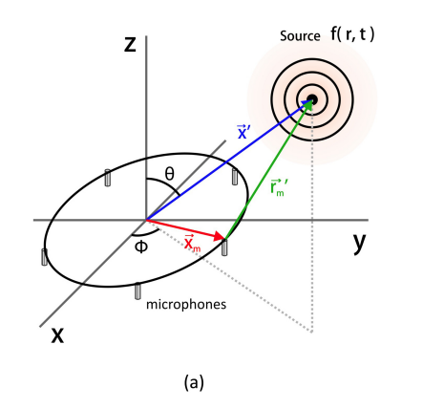
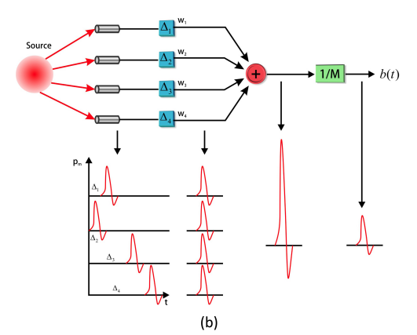

Delay-and-sum (DAS) beamformer
The sound of each source propagates to the microphones in different directions
The signal on each microphone is the same in waveform, but different in delay and phase. Both are proportional to the distance travelled. Delays can be calculated from the speed of sound, the distance between microphones and sources.
The signal from each microphone is shifted by the appropriate delta depending on the focus point (the source to be focused on). As a result, the red pulses are in phase
Signals from all channels are summed up, the sum is normalized to the number of channels. As a result, the amplitude of the desired source is the same as the original source amplitude, and the amplitude of the rest is insignificant.
Considered an array of M microphones whose locations are given by {x_{m}}, m = 1, 2, ..., M, with its center as the origin of coordinates. The classical delay-and-sum beamforming is given by:
where w_{m} is a weighting, ∆m is the time delay applied to the mth microphone and M is the total of microphones.

Slide 9


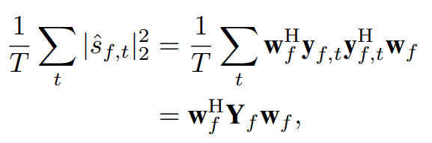



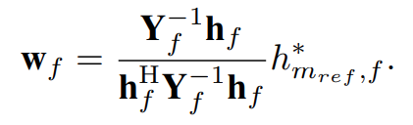
Minimum-variance distortionless response (MVDR) beamformer
Assume that a noisy speech signal is recorded with M microphones
- observation at (f,t), f and t - frequency and time indices
- enhanced speech signal after beamforming, where w_{f} - beamformer coefficient at f
The MVDR beamformer can be derived by minimizing the total power of the beamformer outputs
- covariance matrix of the observed signals
- the steering vector of the target signal
- the transfer gain between the reference microphone and the target source. This linear constraint keeps the beamformer coefficients distortionless in the direction parameterized by h_{f}
A closed-form solution to minimize the objective function with the constraint can be derived as

Slide 10
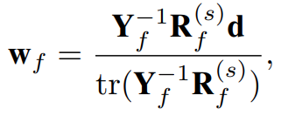

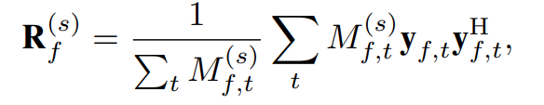
Blind MVDR beamformer
Instead of using the steering vector h_{f} , we can parameterize the MVDR beamformer coefficients by using the covariance matrix of the target signal
where d denotes a one-hot vector whose m_{ref}-th component is one and the other components are zero. R^{(s)}_{f} denotes the covariance matrix of the target signal:
When we assume the sparsity of the target signal and interference, the covariance matrix of the target speech signal R^{(s)}_{f} can be obtained by
where M^{(s)}_{f,t} denotes the time-frequency mask for the target signal

Slide 11

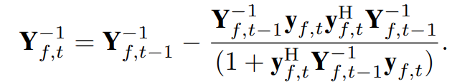

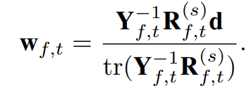
Frame-by-frame update rule for blind MVDR beamformer
We derive an update rule for the coefficients frame-by-frame based on the Woodbury matrix identity, which allows us to obtain the closed-form solution of the MVDR beamformer at every time frame.
To obtain the MVDR beamformer at time t, we compute the inverse matrix of Y_{f,t} based on the Woodbury matrix identity. A recursive update rule for the covariance matrix:
The inverse of the covariance matrix at time t can be obtained based on this and the Woodbury matrix identity
The covariance matrix of the target signal at time t can also be obtained recursively as
The beamformer coefficients can be updated at every time frame by

Slide 12


Source localization: time of arrival (TOA) and time-difference of arrival (TDOA)
m_{i}, 1<i<M - microphones location. The direct path signal at microphone i at time t can be modelled as a time-shifted version of the source signal
δ - Dirac’s delta function, τ_{i} - TOA in the ith microphone
The TOA consists of the propagation delay and an unknown time offset of the ith microphone denoted here as ∆_{i}
s ∈ R³ denotes source position in Cartesian coordinates.
The time difference of arrival (TDOA) between the source and microphones i, j is
where y_{ij} = ∆_{i} − ∆_{j} is the pairwise time offset.

Slide 13



GCC-PHAT and SRP-PHAT
Generalized cross-correlation (GCC) can be used to measure the TDOA values, and PHAT-weighting is often applied in indoor audio applications due to its robustness
The PHAT weighted cross-spectrum between two microphone signals i, j:
where X_{j}(ω) is the ith input signal spectrum from a time frame, and ω is angular frequency
The time domain cross- correlation signal is the inverse Fourier transform of G_{ij}(ω)
Peak location of r_{ij}(τ) then is used to obtain a TDOA estimate
Not the best algorithm, but fast and simple; the maximum correlation may be due to external noise, plus it tends to switch speakers (because the maximum is not always the same), plus it triggers on any disturbances of the acoustic field in general

Slide 14
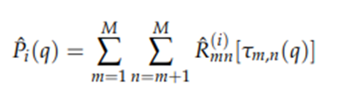
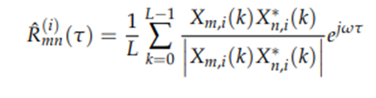


GCC-PHAT and SRP-PHAT
TL;DR: Steered-responce power phase transform creates the virtual grid in space, then choose the cell with maximum value
SRP objective function can be expressed as a sum of Generalized Cross-Correlations (GCCs) for the different microphone pairs at the time-lag corresponding to their TDOA
We can obtain TDOA of a signal emitted at position x to microphones m₁ and m₂
Grid-search procedure evaluates the objective function P(x) on a grid of candidate source locations to estimate the spatial location of the sound source x_{s} as the point of the grid that provides the maximum SRP

Slide 15


Remember DAS beamformer?
A TOA vector τ = [τ₁,... , τ_{M} ]^{T} can be used to form the steering vector of a beamformer at time t
Typically, the TOA values for the microphones are given as a relative delay to a reference microphone with zero delay. The DAS beamformer aligns the desired signal component in the input channels before summation

Slide 16

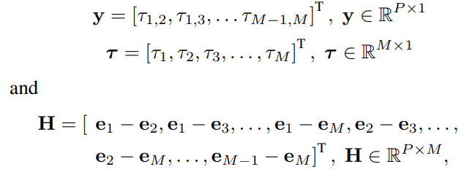

TOA vector estimation
TDOA vector is generated from the TOA values vector τ by the observation matrix H
where the TDOA values are stacked into a vector y, and TOA values are stacked into vector τ
where e_{i} are orthogonal unit vectors

Slide 17





TOA vector estimation
The most simple estimator for relative TOA is to use the pairwise TDOA values τ_{ij} between the first sensor and the others
The first sensor delay is arbitrary - τ₁ = 0. In summary the TOA vector is
Downside - all the information between sensor pairs that do not involve reference sensor is omitted
The TOA vector τ can be solved using the Moore-Penrose inverse and thus utilizing all TDOA measurements. The columns of H are linearly dependent with rank(H) equal to M − 1. Therefore, as in the subset TDOA estimator the absolute offset of each channel is not solvable.
Instead, the relative channel offset is solvable with respect to a reference channel.
Without losing generality the first channel is set as the reference with zero offset value τ₁ = 0. The corresponding first column of the matrix H is removed and the resulting matrix is denoted as H₀. The TOA estimator is
The resulting TOA values are relative to the first sensor offset τ₁ = 0. The TOA vector is

Slide 18





General eigenvalue (GEV) beamformer
TL;DR - it’s mask based beamformer which try to maximize the SNR of beamformer output
Maximizing the SNR of the beamformer output in each frequency bin separately leading to the GEV beamformer with coefficients
Non-overlapping masks M_{X} and M_{N} are used to calculate the weighted sum of products matrices:
The cost function in first equation is known as the Rayleigh coefficient. The optimization problem leads to the well known solution
Unlike the MVDR beamformer, the GEV beamformer can introduce arbitrary speech distortions. These, however, can be reduced using a single channel post-filter
We now obtain an estimate for the source signal as:

